Slide 1
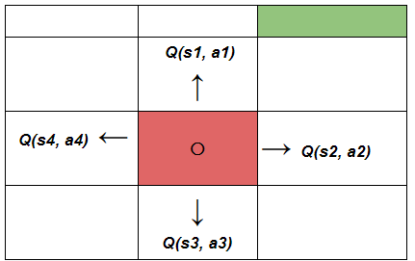
L7.2 Value-based RL
Zonghua Gu 2022
Acknowledgement: slides based on https://www.coursera.org/specializations/reinforcement-learning
And textbook by Sutton and Barto http://incompleteideas.net/book/the-book-2nd.html
Notes:
https://blog.floydhub.com/an-introduction-to-q-learning-reinforcement-learning/

Slide 2
Outline
Introduction
Monte Carlo Methods
TD-Learning
Sarsa & Q-Learning
Function Approximation

Slide 3
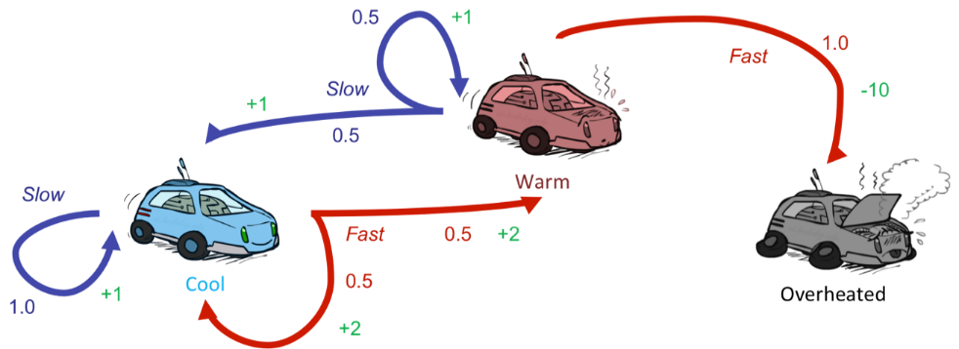
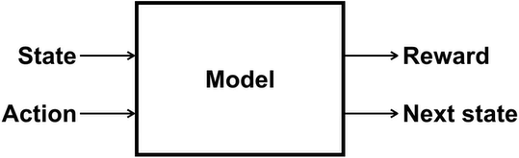
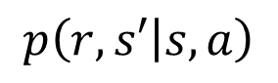
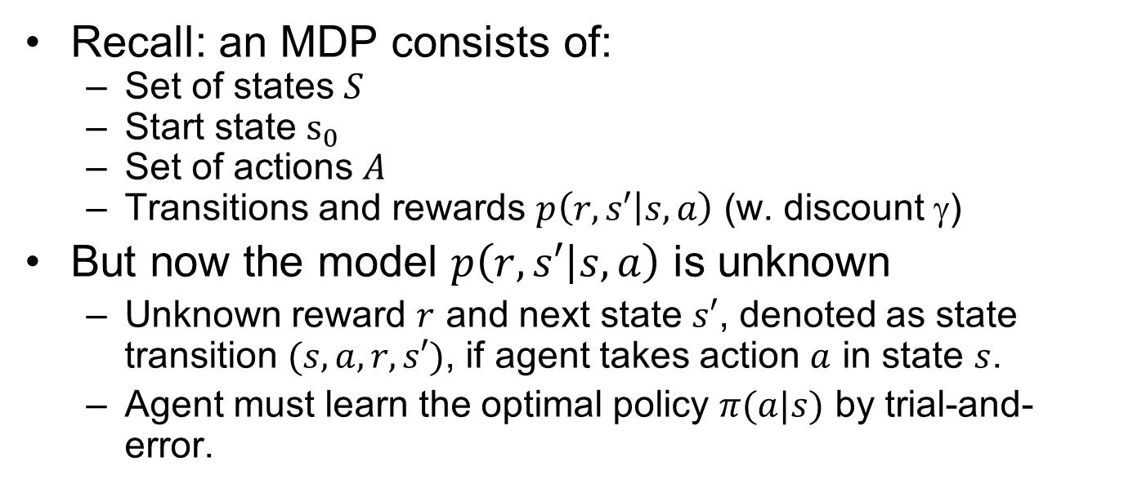
Reinforcement Learning
Recall: an MDP consists of:
Set of states $S$
Start state $s_{0}$
Set of actions $A$
Transitions and rewards $p\left(r,s′ | s,a\right)$ (w. discount $$)
But now the model $p\left(r,s′ | s,a\right)$ is unknown
Unknown reward $r$ and next state $s′$, denoted as state transition $(s,a,r,s′)$, if agent takes action $a$ in state $s$.
Agent must learn the optimal policy $π(a|s)$ by trial-and-error.
$$p\left(r,s′ | s,a\right)$$
Notes:
Still assume an MDP:
A set of states s ∈ S
A set of actions (per state) A
A model T(s,a,s’)
We The same $(s,a)$ may lead to different reward $r$ and next state $s′$, denoted as state transition $(s,a,r,s′)$,
I.e. we don’t know which states are good or what the actions do
A reward function R(s,a,s’)

Slide 4
Characteristics of RL
There is no supervisor, only a reward signal (may be sparse)
Feedback is delayed, not instantaneous
Sequential, non i.i.d (Independent and identically distributed) data
Agent's actions affect the subsequent data it receives
Notes:
What makes RL different from other ML paradigms?

Slide 5
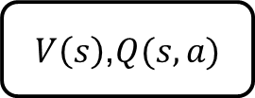
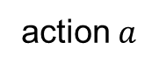
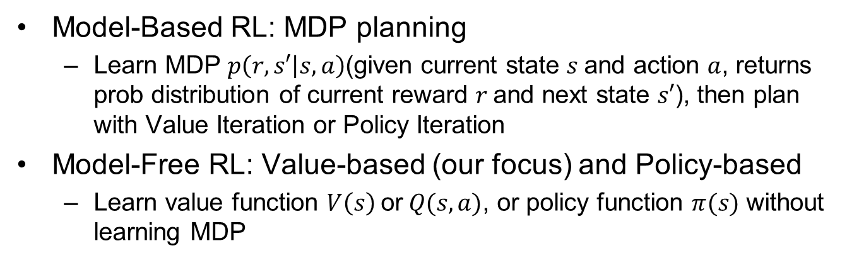
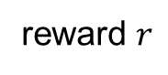
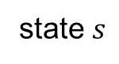

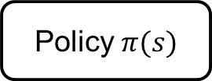
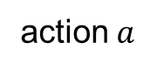
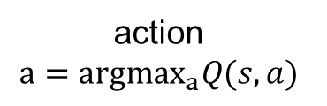
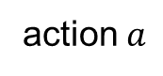
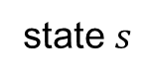
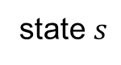
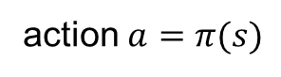
Model-Based vs. Model-Free
Model-Based RL: MDP planning
Learn MDP $p\left(r,s′ | s,a\right)$(given current state $s$and action $a$, returns prob distribution of current reward $r$and next state $s′$), then plan with Value Iteration or Policy Iteration
Model-Free RL: Value-based (our focus) and Policy-based
Learn value function $V\left(s\right)$ or$Q(s,a)$, or policy function $π(s)$ without learning MDP
state $s$
action $a$
state $s$
action $a$
state $s$
action $a$
MDP
$V\left(s\right)$,$Q(s,a)$
Policy $π(s)$
next
state $s′$
reward $r$
action
$$a={argmax}_{a}Q(s,a)$$
action $a=π(s)$
MDP-based RL | Value-based RL | Policy-based RL
Notes:
Model-based RL
Learn MDP model $p\left(r,s′ | s,a\right)$ then use Value Iteration or Policy Iteration to solve for the optimal value function and policy
Model-free (our focus)
Learn the optimal value function and/or policy directly without learning the MDP
Model-based
Learn MDP model $p\left(r,s′ | s,a\right)$, then solve for the optimal policy with PI or VI.
Model-free
Learn the optimal policy without learning MDP.
MPC is model-based; PID can be model-based or model-free $\left[s_{t+1},r_{t}\right]∼P(⋅|s_{t},a_{t};θ)$ $a_{t}=π(s_{t},θ)$ Estimate value $J(θ)$ and optimize it, without knowledge of model $P$Q-Learning/DQN, Policy Gradient, Imitation Learning… $θ$ denotes model params, e.g., edge weights in a DNN.

Slide 6
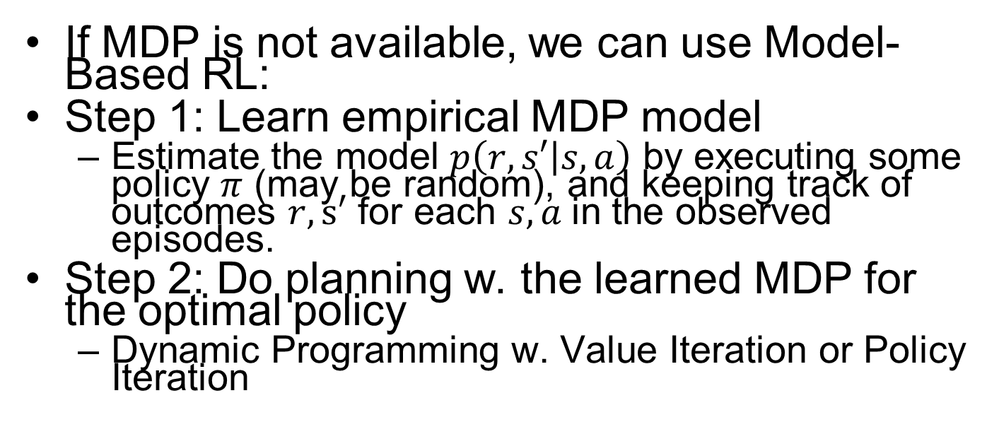
Model-Based RL
If MDP is not available, we can use Model-Based RL:
Step 1: Learn empirical MDP model
Estimate the model $p\left(r,s′ | s,a\right)$ by executing some policy $π$ (may be random), and keeping track of outcomes $r,s′$ for each $s, a$in the observed episodes.
Step 2: Do planning w. the learned MDP for the optimal policy
Dynamic Programming w. Value Iteration or Policy Iteration
Notes:
Learn an approximate MSP based on experiences, then solve the learned MDP
counting transitions out of each state
CH08: Planning and Learning
Normalize to estimate the probabilities $p\left(r,s′ | s,a\right)$

Slide 7
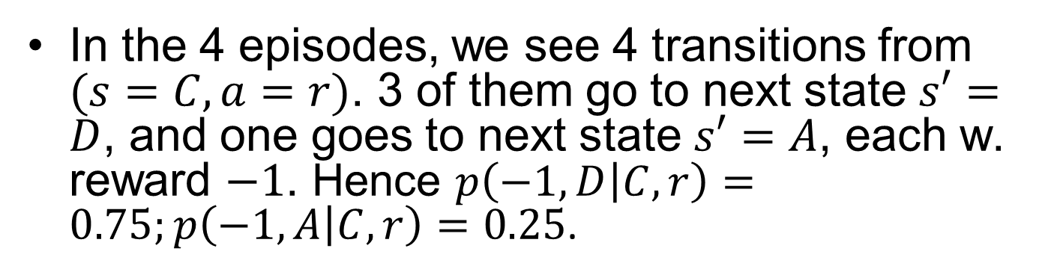
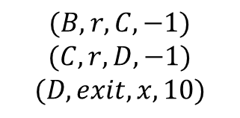
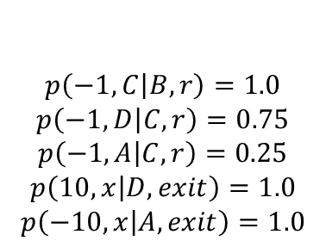
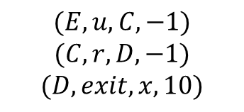
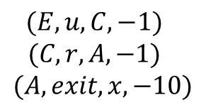
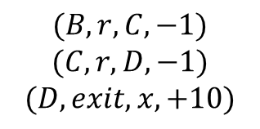
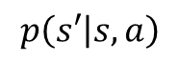
MiniGW: Model Learning
Input Policy π
Observed Episodes (Training)
Learned Model
Episode 1
Episode 2
$$p\left(s′ | s,a\right)$$
$$p\left(−1,C | B,r\right)=1.0$$
$$p\left(−1,D | C,r\right)=0.75$$
$$p\left(−1,A | C,r\right)=0.25$$
$$p\left(10,x | D,exit\right)=1.0$$
$$p\left(−10,x | A,exit\right)=1.0$$
 | A
B | C | D
 | E
$$(B, r, C, −1)$$
$$(C, r, D, −1)$$
$$(D, exit, x, 10)$$
$$(B, r, C, −1)$$
$$(C, r, D, −1)$$
$$(D, exit, x, +10)$$
Episode 3
Episode 4
$$(E, u, C, −1)$$
$$(C, r, D, −1)$$
$$(D, exit, x, 10)$$
$$(E, u, C, −1)$$
$$(C, r, A, −1)$$
$$(A, exit, x, −10)$$
Assume: γ = 1
In the 4 episodes, we see 4 transitions from $(s=C, a=r)$. 3 of them go to next state $s′=D$, and one goes to next state $s′=A$, each w. reward $−1$. Hence $p\left(−1,D | C,r\right)=0.75;p\left(−1,A | C,r\right)=0.25$.
Notes:
(may update $π$ and re-learn $\hat{T}(s,a,s’)$ iteratively)

Slide 8
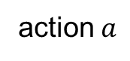
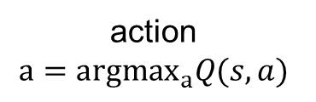
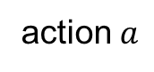
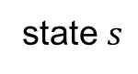
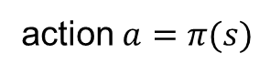
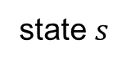
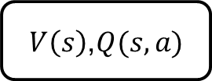
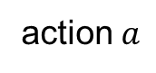
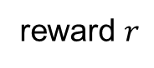
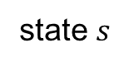

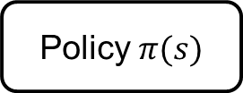
Value-based RL
state $s$
action $a$
state $s$
action $a$
state $s$
action $a$
MDP
$V\left(s\right)$,$Q(s,a)$
Policy $π(s)$
next
state $s′$
reward $r$
action
$$a={argmax}_{a}Q(s,a)$$
action $a=π(s)$
MDP Planning | Value-based RL | Policy-based RL

Slide 9
Outline
Introduction
Monte Carlo Methods
TD-Learning
Sarsa & Q-Learning
Function Approximation

Slide 10
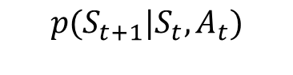
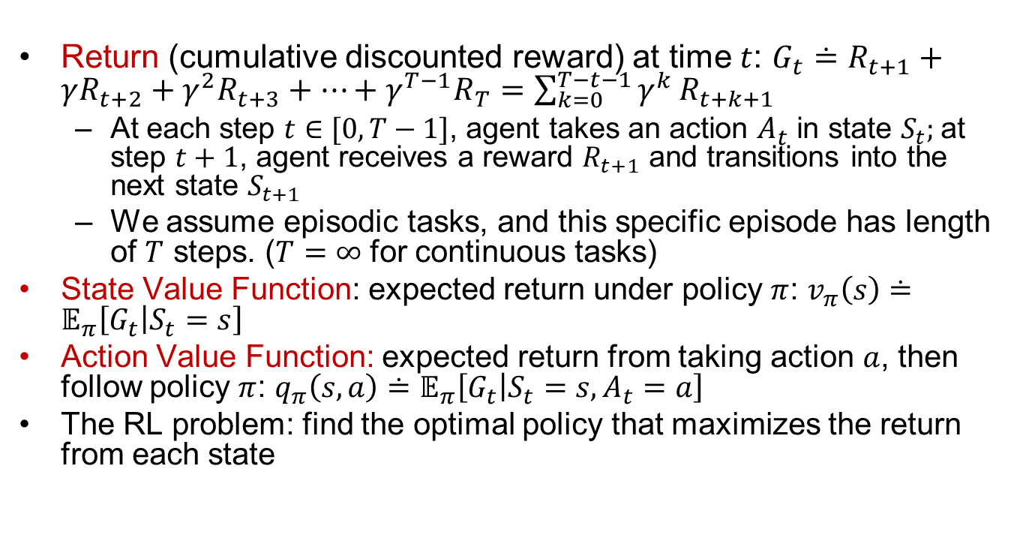
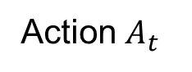
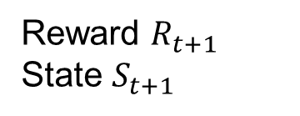
Recall: Definitions of Terms
Return (cumulative discounted reward) at time $t$: $G_{t}≐R_{t+1}+γR_{t+2}+γ^{2}R_{t+3}+…+γ^{T−1}R_{T}=\sum_{k=0}^{T−t−1}{γ^{k}}R_{t+k+1}$
At each step $t∈[0,T−1]$, agent takes an action $A_{t}$ in state $S_{t}$; at step $t+1$, agent receives a reward $R_{t+1}$ and transitions into the next state $S_{t+1}$
We assume episodic tasks, and this specific episode has length of $T$ steps. ($T=∞$ for continuous tasks)
State Value Function: expected return under policy $π$: $v_{π}\left(s\right)≐𝔼_{π}\left[G_{t} | S_{t}=s\right]$
Action Value Function: expected return from taking action $a$, then follow policy $π$: $q_{π}\left(s,a\right)≐𝔼_{π}\left[G_{t} | S_{t}=s,A_{t}=a\right]$
The RL problem: find the optimal policy that maximizes the return from each state
$${p(S}_{t+1}|S_{t},A_{t})$$
Environment
Action $A_{t}$
Reward $R_{t+1}$
State $S_{t+1}$
RL Agent

Slide 11
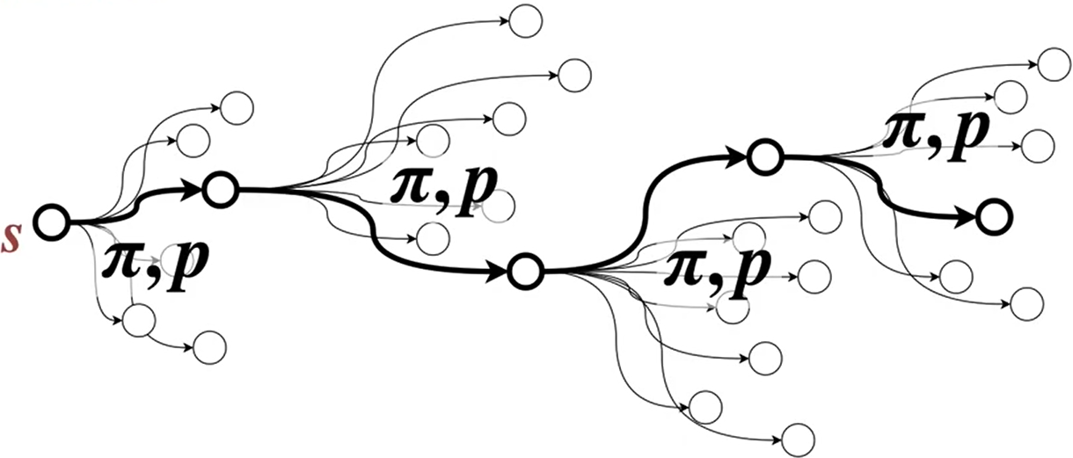
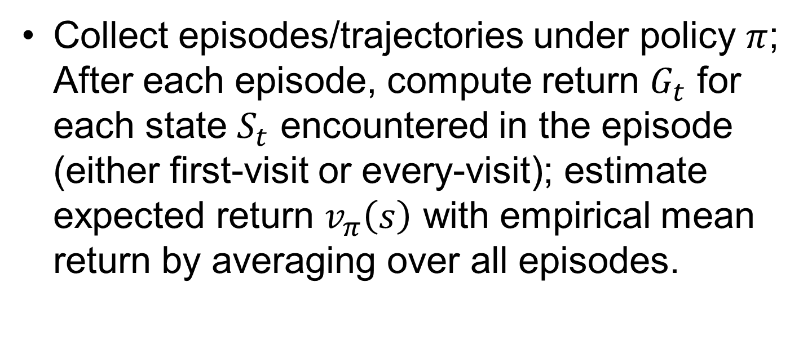
Monte Carlo (MC) Prediction (Policy Evaluation)
Collect episodes/trajectories under policy $π$; After each episode, compute return $G_{t}$ for each state $S_{t}$ encountered in the episode (either first-visit or every-visit); estimate expected return $v_{π}\left(s\right)$ with empirical mean return by averaging over all episodes.
Notes:
containing particular $s$ or $(s,a)$
trajectory starting from $s$ or $(s,a)$
state $S_{t}$
Or 2) Inre
Compare to every-visit MC w.

Slide 12
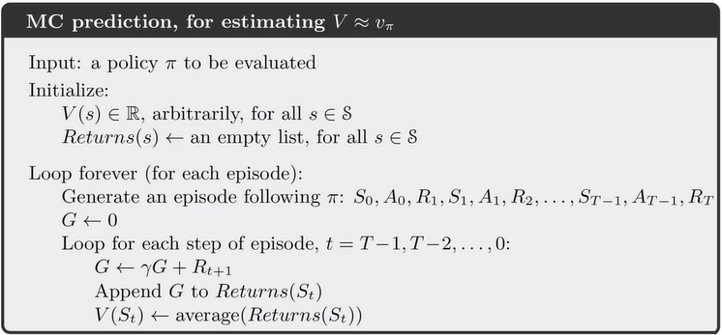
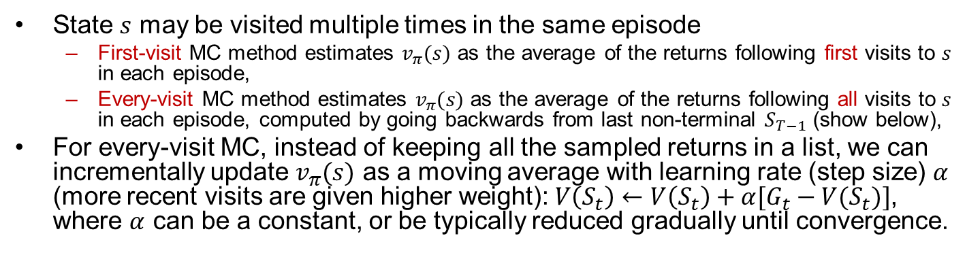
MC Prediction Details
State $s$ may be visited multiple times in the same episode
First-visit MC method estimates $v_{π}(s)$ as the average of the returns following first visits to $s$ in each episode,
Every-visit MC method estimates $v_{π}(s)$ as the average of the returns following all visits to $s$ in each episode, computed by going backwards from last non-terminal $S_{T−1}$ (show below),
For every-visit MC, instead of keeping all the sampled returns in a list, we can incrementally update $v_{π}(s)$ as a moving average with learning rate (step size) $α$ (more recent visits are given higher weight): $V\left(S_{t}\right)←V\left(S_{t}\right)+α[G_{t}−V(S_{t})]$, where $α$ can be a constant, or be typically reduced gradually until convergence.
Notes:
First-visit MC method estimates v⇡(s) as the average of the returns following
first visits to s, whereas the every-visit MC method averages the returns following all
visits to s.
State Value Function update (incremental):
$$V\left(S_{t}\right)←V\left(S_{t}\right)+α(G_{t}−V(S_{t}))$$
Can compute running avg w. incremental update $V(S_{t})←_{α}Returns(S_{t})$
; let us call the first time it is visited in an episode the first visit to $s$.

Slide 13
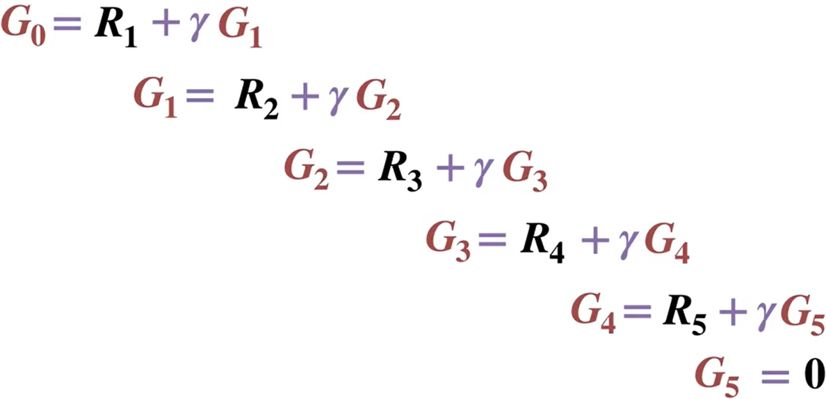
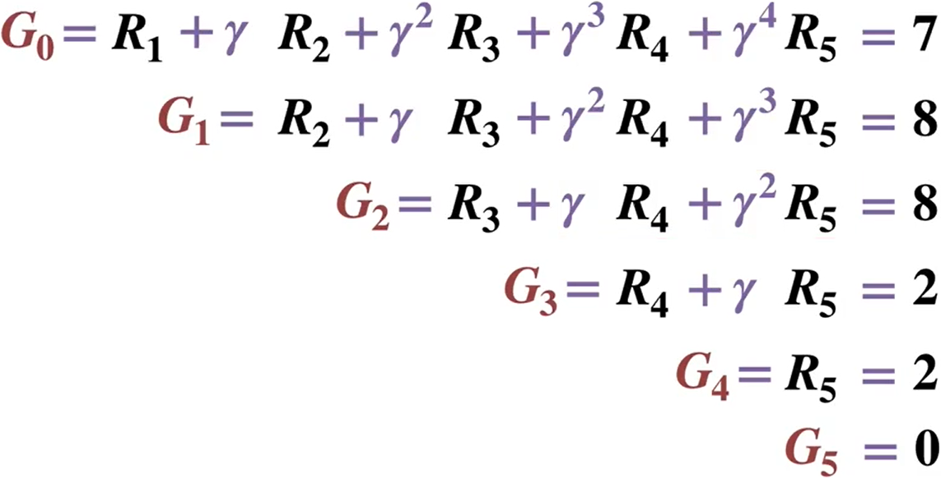
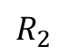
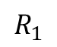
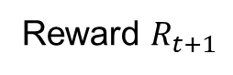
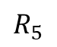



Example: Computing Returns for One Episode
Working backward is more efficient than working forward as it avoids redundant computations.
$$R_{1}$$
$$R_{2}$$
$$R_{3}$$
$$R_{4}$$
$$R_{5}$$
Reward $R_{t+1}$
Step $t$
0
1
2
3
4
5

Slide 14




Exploration in MC Prediction for $q_{π}\left(s,a\right)$
For any policy (det or sto): exploring starts
Specify that the episodes start in $(s_{0},a_{0})$, and that every possible $(s,a)$ has a nonzero probability of being selected as the start.
From $(s_{1},a_{1})$ follow policy $π$ for action selection
$s_{0},a_{0},s_{1},a_{1},s_{2},a_{2},…$
May not be always feasible for complex environments.
For stochastic policy
$ε$-greedy (or $ε$-soft)

Slide 15
Exploration-Exploitation Dilemma
The agent has to exploit what it has already experienced in order to obtain reward, but it also has to explore in order to make better action selections in the future.
Exploitation: to obtain a lot of reward, the agent must prefer actions that it has tried in the past and found to be effective in producing reward.
Exploration: to discover such actions, it has to try actions that it has not selected before.
Notes:
On a stochastic task, each action must be tried many times to gain a reliable estimate of its expected reward.
The dilemma is that neither exploration nor exploitation can be pursued exclusively without failing at the task. The agent must try a variety of actions and progressively favor those that appear to be best.

Slide 16



$ε$-Greedy as One Type Of $ε$-Soft
$ε$-greedy policy: select a random action w. prob $ε$ (exploration); select the greedy action $\underset{a}{argmax}{Q(s,a)}$ with prob $1−ε$ (exploitation)
With $\left|𝒜(s)\right|$ possible actions in state $s$, select each non-greedy action w. prob $\frac{ε}{\left|𝒜\left(s\right)\right|}$; the greedy action w. prob $1−ε+\frac{ε}{\left|𝒜\left(s\right)\right|}$
$ε$-soft policy: $π\left(a | s\right)≥\frac{ε}{\left|𝒜\left(s\right)\right|}$ for all $(s,a)$, and for some $ε>0$
$ε$-greedy policy is a special case of $ε$-soft policy
Notes:
e.g., softmax policy $π\left(a | s\right)∼e^{q\left(s,a\right)}$ w. additional lower bound

Slide 17



Optimal $ε$-Soft Policy
The optimal $ε$-soft policy is the policy with the highest value in each state among all $ε$-soft policies. It performs worse than the optimal greedy deterministic policy $π_{∗}$ in general.
But it often performs reasonably well, and avoids exploring starts.
Notes:
If our policy always gives at least Epsilon probability to each action, it's impossible to converge to a deterministic optimal policy exploring starts can be used to find the optimal policy. But that's on

Slide 18
Outline
Introduction
Monte Carlo Methods
TD-Learning
Sarsa & Q-Learning
Function Approximation

Slide 19

Exponential Moving Average
The running average update: ${\overline{x}}_{n}←\left(1−α\right){\overline{x}}_{n−1}+αx_{n}={\overline{x}}_{n−1}+α(x_{n}−{\overline{x}}_{n−1})$
Shorthand notation ${\overline{x}}_{n}←_{α}x_{n}$
Makes recent samples more important (since later ones are more accurate estimates)
${\overline{x}}_{n}=α\left(x_{n}+\left(1−α\right)(αx_{n−1}+\left(1−α\right)(…)\right))$
$$=α\left(x_{n}+\left(1−α\right)x_{n−1}+{\left(1−α\right)}^{2}x_{n−2}+…\right)=\frac{x_{n}+\left(1−α\right)x_{n−1}+{\left(1−α\right)}^{2}x_{n−2}+…}{1+\left(1−α\right)+{\left(1−α\right)}^{2}+…}$$
Since $\frac{1}{α}=$ $1+\left(1−α\right)+{\left(1−α\right)}^{2}+…$
Forgets about the past gradually (distant past values are likely to be wrong, esp. for changing env.)
Decreasing learning rate $α$ gradually can give converging average.
Notes:
More recent samples are better because the estimates for vk are better

Slide 20

TD Learning
Recall Bellman Exp. Equation:
$v_{π}\left(s\right)=\sum_{a}{π\left(a | s\right)}\sum_{r,s^{′}}{p\left(r,s′ | s,a\right)}\left[r+γv_{π}\left(s^{′}\right)\right]=𝔼_{π}[R_{t+1}+γv_{π}(S_{t+1})|S_{t}=s]$
To solve it with dynamic programming, we need the MDP model $p\left(r,s′ | s,a\right)$.
TD Learning: compute $v_{π}\left(s\right)$ in model-free way by sampling.
$V\left(S_{t}\right)=𝔼\left[R_{t+1}+γR_{t+2}+γ^{2}R_{t+3}+…\right]$
$V\left(S_{t+1}\right)=𝔼\left[R_{t+2}+γR_{t+3}+γ^{2}R_{t+4}+…\right]$
TD Target: $R_{t+1}+γV\left(S_{t+1}\right)=R_{t+1}+γ𝔼\left[R_{t+2}+γR_{t+3}+γ^{2}R_{t+4}+…\right]$
At every timestep $t$, update $V\left(S_{t}\right)$ for current state $S_{t}$:
$V\left(S_{t}\right)←V\left(S_{t}\right)+α(R_{t+1}+γV\left(S_{t+1}\right)−V(S_{t}))$
TD Target: $R_{t+1}+γV\left(S_{t+1}\right)$
TD Error: $δ_{t}=R_{t+1}+γV\left(S_{t+1}\right)−V(S_{t})$
Notes:
Shorthand: $V\left(S_{t}\right)←_{α}(R_{t+1}+γV\left(S_{t+1}\right))$
$$G_{t}≐R_{t+1}+γR_{t+2}+γ^{2}R_{t+3}+…+γ^{T−1}R_{T}$$
$$V\left(S_{t}\right)=R_{t+1}+γR_{t+2}+γ^{2}R_{t+3}$$

Slide 21

Update Equations: MC vs. TD
MC (every-visit): After every episode, update $V\left(S_{t}\right)$ for all states encountered in the episode:
On-policy MC:$V\left(S_{t}\right)←V\left(S_{t}\right)+α(G_{t}−V(S_{t}))$
Off-policy MC w. Importance Sampling: $V\left(S_{t}\right)←V\left(S_{t}\right)+α(ρ_{t:T−1}G_{t}−V(S_{t}))$
$ρ_{t:T−1}=\prod_{k=t}^{T−1}{\frac{π\left(A_{k} | S_{k}\right)}{b\left(A_{k} | S_{k}\right)}}$
TD: At every timestep $t$, update $V\left(S_{t}\right)$ for current state $S_{t}$:
On-policy TD:$V\left(S_{t}\right)←V\left(S_{t}\right)+α(R_{t+1}+γV\left(S_{t+1}\right)−V(S_{t}))$
Off-policy TD w. Importance Sampling: $V\left(S_{t}\right)←V\left(S_{t}\right)+α({ρ_{t}(R}_{t+1}+γV\left(S_{t+1}\right))−V(S_{t}))$
$ρ_{t}=\frac{π\left(A_{t} | S_{t}\right)}{b\left(A_{t} | S_{t}\right)}$
Much lower variance than MC w. Importance Sampling: $V\left(S_{t}\right)←V\left(S_{t}\right)$.

Slide 22


Tabular TD(0)
MC updates $V(S)$ at the end of each episode.
TD updates $V(S)$ at every time step.
Bootstrapping $V(S)$ from $V(S^{′})$

Slide 23


TD vs. MC: Random Walk Example
Agent has uniform random policy, w. equal prob of going left or right at each timestep. Env is deterministic. All episodes start in state $C$. Episodes terminate either on the left or on the right. The reward is $0$ on all transitions except $1$ for terminating on the right. Discount factor $γ=1$: learning rate $α=0.5$.
Value of state $V(s)$ is the probability of terminating on the right when starting from state $s$. For known MDP, they can be computed by Policy Evaluation w. the set of Bellman Exp Equations,w. solution shown in the figure:
$V\left(A\right)=0.5V(B)$
$V\left(B\right)=0.5V\left(A\right)+0.5V(C)$
$V\left(C\right)=0.5V\left(B\right)+0.5V(D)$
$V\left(D\right)=0.5V\left(C\right)+0.5V(E)$
$V\left(E\right)=0.5V\left(D\right)+0.5⋅1$
Next, for unknown MDP, we use TD or MC to learn $V(s)$. Initialize all $V(⋅)=0.5.$
Notes:
Agent takes a random action of left or right
https://www.coursera.org/learn/sample-based-learning-methods/lecture/CEzFc/comparing-td-and-monte-carlo

Slide 24




Episode1 $(C,r,0,D,r,0,E,r,1,T)$
TD:
$V\left(C\right)←V\left(C\right)+α\left[R_{t+1}+γV\left(D\right)−V\left(C\right)\right]=.5+.5\left(0+.5−.5\right)=0.5$
$V\left(D\right)←V\left(D\right)+α\left[R_{t+1}+γV\left(E\right)−V\left(D\right)\right]=.5+.5\left(0+.5−.5\right)=0.5$
$V\left(E\right)←V\left(E\right)+α\left[R_{t+1}+γV\left(T\right)−V\left(E\right)\right]=.5+.5\left(1+0−.5\right)=0.75$
MC: (every-visit. when used as subscript, $T$ denotes the time instant of reaching the terminal state)
$G\left(E\right)=R_{T}=1,G\left(D\right)=R_{T−1}+γG\left(E\right)=0+1⋅1=1,G\left(C\right)=R_{T−2}+γG\left(D\right)=0+1⋅1=1$
$V\left(C\right)←V\left(C\right)+α\left[G(C)−V\left(C\right)\right]=.5+.5\left(1−.5\right)=0.75$
$V\left(D\right)←V\left(D\right)+α\left[G(D)−V\left(D\right)\right]=.5+.5\left(1−.5\right)=0.75$
$V\left(E\right)←V\left(E\right)+α\left[G(E)−V\left(E\right)\right]=.5+.5\left(1−.5\right)=0.75$
$$V\left(S_{t}\right)←V\left(S_{t}\right)+α(G_{t}−V(S_{t}))$$
_{t=T}
_{t=T-3}
_{t=T-2}
_{t=T-1}
Notes:
Agent Terminating On The Right for 1st Time
$$V\left(D\right)←V\left(D\right)+α\left[G(D)−V\left(D\right)\right]=.5+.5\left(1−.75\right)=0.75$$
$$V\left(C\right)←V\left(C\right)+α\left[G−V\left(C\right)\right]=.5+.5\left(1−.5\right)=0.75$$
MC update equation: $V\left(S_{t}\right)←V\left(S_{t}\right)+α\left(G_{t}−V\left(S_{t}\right)\right)=G_{t}$
TD update equation: $V\left(S_{t}\right)←V\left(S_{t}\right)+α\left(R_{t+1}+γV\left(S_{t+1}\right)−V\left(S_{t}\right)\right)=R_{t+1}+γV\left(S_{t+1}\right)$

Slide 25

Quiz on TD vs. MC
Q: Is the following a more efficient TD update sequence with backward, in-place updates?
$V\left(E\right)←V\left(E\right)+α\left[R_{t+1}+γV\left(T\right)−V\left(E\right)\right]=.5+.5\left(1+0−.5\right)=0.75$
$V\left(D\right)←V\left(D\right)+α\left[R_{t+1}+γV\left(E\right)−V\left(D\right)\right]=.5+.5\left(0+.75−.5\right)=0.625$
$V\left(C\right)←V\left(C\right)+α\left[R_{t+1}+γV\left(D\right)−V\left(C\right)\right]=.5+.5\left(0+.625−.5\right)=0.5625$
A: This is not feasible since TD updates $V(S)$ at every time step, and does not keep track of the history of visited states
Q: Can we use backward, in-place updates for MC?
$V\left(E\right)←V\left(E\right)+α\left[G(E)−V\left(E\right)\right]=.5+.5\left(1−.5\right)=0.75$
$V\left(D\right)←V\left(D\right)+α\left[G(D)−V\left(D\right)\right]=.5+.5\left(1−.5\right)=0.75$
$V\left(C\right)←V\left(C\right)+α\left[G(C)−V\left(C\right)\right]=.5+.5\left(1−.5\right)=0.75$
A: Yes, but it makes no difference in this example whether you use forward or backward update for $V(S_{t})$, which is based on $G(S_{t})$, not bootstrapped off $V(S_{t+1})$.
For every-visit MC using $V\left(S_{t}\right)←V\left(S_{t}\right)+α[G_{t}−V(S_{t})]$ to update each state’s value function, we should use forward update to give more recent visits higher weight, in case the same state is visited multiple times in one episode (refer to p.13 “MC Prediction Details”)
Notes:
For every-visit MC, instead of keeping all the sampled returns in a list, we can incrementally update $v_{π}(s)$ as a moving average with learning rate (step size) $α$ (more recent visits are given more weight): $V\left(S_{t}\right)←V\left(S_{t}\right)+α[G_{t}−V(S_{t})]$, where $α$ can be constant, or be typically reduced gradually until convergence.

Slide 26



Episode2 Pt1 $(C,r,0,D,r,0,E)$
TD:
$V\left(C\right)←V\left(C\right)+α\left[R_{t+1}+γV\left(D\right)−V\left(C\right)\right]=.5+.5\left(0+.5−.5\right)=0.5$
$V\left(D\right)←V\left(D\right)+α\left[R_{t+1}+γV\left(E\right)−V\left(D\right)\right]=.5+.5\left(0+.75−.5\right)=0.625$
MC:
No update since episode has not ended.

Slide 27



Episode2 Pt2 $(E,l,0,D,l,0,C)$
TD:
$V\left(E\right)←V\left(E\right)+α\left[R_{t+1}+γV\left(D\right)−V\left(E\right)\right]=.75+.5\left(0+.625−.75\right)≈0.688$
$V\left(D\right)←V\left(D\right)+α\left[R_{t+1}+γV\left(C\right)−V\left(D\right)\right]=.625+.5\left(0+.5−.625\right)≈0.563$
MC:
No update since episode has not ended.

Slide 28



Episode2 Pt3 $(C,r,0,D,r,0,E)$
TD:
$V\left(C\right)←V\left(C\right)+α\left[R_{t+1}+γV\left(D\right)−V\left(C\right)\right]=.5+.5\left(0+.563−.5\right)≈0.531$
$V\left(D\right)←V\left(D\right)+α\left[R_{t+1}+γV\left(E\right)−V\left(D\right)\right]=.563+.5\left(0+.688−.563\right)≈0.625$
MC:
No update since episode has not ended.

Slide 29


Episode2 Pt4 $(E,r, 1,T)$
TD:
$V\left(E\right)←V\left(E\right)+α\left[R_{t+1}+γV\left(T\right)−V\left(E\right)\right]=.688+.5\left(1+0−.688\right)=0.844$
0.531
0.625
0.844
0.938
0.969
0.938
Notes:
TD:
MC:$G\left(E\right)=R_{3}=1, V(E)←V\left(E\right)+α\left[G(E)−V\left(E\right)\right]=.5+.5\left(1−.5\right)=0.75$
$$G\left(D\right)=R_{2}+γG\left(E\right)=0+1⋅1=1, V(D)←V\left(D\right)+α\left[G(D)−V\left(D\right)\right]=.5+.5\left(1−.5\right)=0.75$$
$$G\left(C\right)=R_{1}+γG\left(D\right)=0+1⋅1=1, V\left(C\right)←V\left(C\right)+α\left[G\left(C\right)−V\left(C\right)\right]=.5+.5\left(1−.5\right)=0.75$$

Slide 30


Episode2 Pt4 $(E,r, 1,T)$
MC (every-visit w. episode $C′→D′′→E′→D′→C→D→E→T$):
Update $G\left(s\right)$ backward:
$G\left(E\right)=R_{T}=1, G\left(D\right)=R_{T−1}+γG\left(E\right)=0+1=1, G\left(C\right)=R_{T−2}+γG\left(D\right)=0+1=1$
$G(D′)=R_{T−1}+γG\left(C\right)=0+1=1 ,G(E′) =R_{T−1}+γG\left(D′\right)=0+1=1$
$G(D′′)=R_{T−1}+γG(E′)=0+1=1,G(C′)=R_{T−1}+γG(D′′)=0+1=1$
Update $V\left(s\right)$ forward:
$V\left(C\right)←V\left(C\right)+α\left[G(C′)−V\left(C\right)\right]=.75+.5\left(1−.75\right)=0.875$
$V\left(D\right)←V\left(D\right)+α\left[G(D′′)−V\left(D\right)\right]=.75+.5\left(1−.75\right)=0.875$
$V\left(E\right)←V\left(E\right)+α\left[G(E′)−V\left(E\right)\right]=.75+.5\left(1−.75\right)=0.875$
$V\left(D\right)←V\left(D\right)+α\left[G(D′)−V\left(D\right)\right]=.875+.5\left(1−.875\right)≈0.938$
$V\left(C\right)←V\left(C\right)+α\left[G\left(C\right)−V\left(C\right)\right]=.875+.5\left(1−.875\right)≈0.938$
$V\left(D\right)←V\left(D\right)+α\left[G\left(D\right)−V\left(D\right)\right]=0.938+.5\left(1−0.938\right)=0.969$
$V\left(E\right)←V\left(E\right)+α\left[G\left(E\right)−V\left(E\right)\right]=.875+.5\left(1−.875\right)≈0.938$

Slide 31


TD vs. MC: Random Walk Performance
Left fig shows values learned after various numbers of episodes on a single run of TD(0),
They are very close to the true values after 100 episodes, but they fluctuate indefinitely in response to the outcomes of the most recent episodes.
Right fig shows Root Mean-Squared (RMS) error between the value function learned and the true value function, averaged over the five states, then averaged over 100 runs.
TD converges faster than MC. Higher learning rate $α$helps achieve faster convergence, but has large fluctuations.

Slide 32


MC Prediction for MiniGW
Input Policy π
Observed Episodes (Training)
Output Values
Episode 1
Episode 2
-10
 | A
B | C | D
 | E
B, east, C, -1
C, east, D, -1
D, exit, x, +10
B, east, C, -1
C, east, D, -1
D, exit, x, +10
 | A
B | C | D
 | E
+8
+4
+10
Episode 3
Episode 4
E, north, C, -1
C, east, D, -1
D, exit, x, +10
E, north, C, -1
C, east, A, -1
A, exit, x, -10
-2
Assume: γ = 1
State A:
Episode 4: $G_{t}\left(A\right)=−10$
$\hat{V}\left(A\right)=\frac{−10}{1}=−10,$
State D:
Episodes 1,2, 4: $G_{t}\left(D\right)=$ $10$
$\hat{V}\left(D\right)=\frac{10⋅3}{3}=10,$
State $B$:
Episodes 1 and 2: $G_{t}\left(B\right)=$ $−1−1+10=8$; $\hat{V}\left(B\right)=\frac{1}{2}\left(8+8\right)=8$
State $C$:
Episodes 1,2,3: $G_{t}\left(C\right)=−1+10=9$
Episode 4: $G_{t}\left(C\right)= −1−10=−11$
$\hat{V}\left(C\right)=\frac{1}{4}\left(9+9+9−11\right)=4$
State $E$:
Episode 3: $G_{t}\left(E\right)=−1−1+10=8$
Episode 4: $G_{t}\left(E\right)=−1−1−10=−12$
$\hat{V}\left(E\right)=\frac{1}{2}\left(8−12\right)=−2$
Notes:
This is called MCTS

Slide 33

MC Prediction for MiniGW
From Policy Evaluation, we have derived $V\left(B\right)=V(E)$. But the MC predicted value functions are inaccurate due to limited sampling:
$\hat{V}\left(B\right)=8$, since both episodes 1 and 2 start from $B$ and end in $D$ with $V\left(D\right)=10$;
$\hat{V}\left(E\right)=−2$, since episodes 3 and 4 start from $E$ and end in either $D$ or $A$ with $V\left(D\right)=10,V\left(A\right)=−10$.
If we sample more data, then we can estimate more accurate values.
MC learning is not sample-efficient, since value function of each state must be learned separately.
Output Values
-10
 | A
B | C | D
 | E
+8
+4
+10
-2
If B and E both go to C under this policy, how can their values be different?
Notes:
Pros:
It is model-free
It eventually computes the correct average values, using just sample transitions
Cons:
It wastes information about state connections
Each state must be learned separately
It is not sample efficient

Slide 34


TD Learning, $α=0.5$
4 episodes with transitions {(B, east, C), (C, east, D)}.
TD update: $v_{π}\left(B\right)←_{α}−1+γv_{π }\left(C\right);v_{π}\left(B\right)←_{α}−1+γv_{π }\left(D\right)$
EP1:
Transition (B, east, C): $V^{π}\left(B\right)←0+α\left(−1+0−0\right)=−.5$
Transition (C, east, D): $V^{π}\left(C\right)←0+α\left(−1+10−0\right)=4.5$
EP2:
Transition (B, east, C): $V^{π}\left(B\right)←−.5+α\left(−1+4.5−(−.5)\right)=1.5$
Transition (C, east, D): $V^{π}\left(C\right)←4.5+α\left(−1+10−4.5\right)=6.75$
EP3:
Transition (B, east, C): $V^{π}\left(B\right)←1.5+α\left(−1+6.75−1.5\right)=3.625$
Transition (C, east, D): $V^{π}\left(C\right)←6.75+α\left(−1+10−6.75\right)=7.875$
EP4:
Transition (B, east, C): $V^{π}\left(B\right)←3.625+α\left(−1+7.875−3.625\right)=5.25$
Transition (C, east, D): $V^{π}\left(C\right)←7.875+α\left(−1+10−7.875\right)=8.4375$
After many repetitions of the episode {(B, east, C), (C, east, D)}, $V^{π}\left(B\right)≈7,V^{π}\left(C\right)≈9$
Notes:
Suppose we observe transitions (B, east, C, -2) and (C, east, D, -2). After many iterations, TD learning may converge to the true values $V\left(B\right)=8;V\left(C\right)=9$
$$V^{π}\left(s\right)←\left(1−α\right)V^{π}\left(s\right)+α(R(s,π(s),s′)+γV^{π}\left(s′\right))$$

Slide 35


TD Learning, $α=0.9$
4 episodes with transitions {(B, east, C), (C, east, D)}.
TD update: $v_{π}\left(B\right)←_{α}−1+γv_{π }\left(C\right);v_{π}\left(B\right)←_{α}−1+γv_{π }\left(D\right)$
EP1:
Transition (B, east, C): $V^{π}\left(B\right)←0+α\left(−1+0−0\right)=−.9$
Transition (C, east, D): $V^{π}\left(C\right)←0+α\left(−1+10−0\right)=8.1$
EP2:
Transition (B, east, C): $V^{π}\left(B\right)←−.9+α\left(−1+8.1−(−.9)\right)=3.1$
Transition (C, east, D): $V^{π}\left(C\right)←8.1+α\left(−1+10−8.1\right)=8.91$
EP3:
Transition (B, east, C): $V^{π}\left(B\right)←3.1+α\left(−1+8.91−3.1\right)=5.505$
Transition (C, east, D): $V^{π}\left(C\right)←8.91+α\left(−1+10−8.91\right)=8.991$
EP4:
Transition (B, east, C): $V^{π}\left(B\right)←5.505+α\left(−1+8.991−5.505\right)=6.748$
Transition (C, east, D): $V^{π}\left(C\right)←8.991+α\left(−1+10−8.991\right)=8.9991$
After many repetitions of the episode {(B, east, C), (C, east, D)}, $V^{π}\left(B\right)≈7,V^{π}\left(C\right)≈9$. Converges faster than $α=0.5$
Notes:
Suppose we observe transitions (B, east, C, -2) and (C, east, D, -2).

Slide 36


Backup Diagrams: MC vs. TD vs. DP
Important

Slide 37

MC vs. TD
TD can learn before knowing the final outcome
TD can learn online after every step
MC must wait until end of each episode before return is known
TD can learn without the final outcome
TD can learn from incomplete episodes
MC can only learn from complete episodes
TD works in continuing (non-terminating) environments
MC only works for episodic (terminating) environments
MC has high variance, zero bias
Return $G_{t}≐\sum_{k=0}^{T−1}{γ^{k}R_{t+k+1}}$ is unbiased estimate of $v_{π}(S_{t})$; converges to $v_{π}(S_{t})$ (even with function approximation)
Return depends on many random actions, transitions, rewards in each episode
Not very sensitive to initial value
TD has low variance, some bias
TD target $R_{t+1}+γV\left(S_{t+1}\right)$ is biased estimate of $v_{π}(S_{t})$; TD(0) converges to $v_{π}(S_{t})$ (but not always with function approximation)
TD target depends on one random action, transition, reward
More sensitive to initial value
MC does not exploit Markov property
More effective in non-Markov environments, e.g., Partially Observed MDP (POMDP)
TD exploits Markov property
Does not work well for POMPDP
Notes:
Usually more ecient than MC
May need many samples to get accurate estimate, due to high variance caused by random policy and stochastic environment.

Slide 38
Outline
Introduction
Monte Carlo Methods
TD-Learning
Sarsa & Q-Learning
Function Approximation

Slide 39
Outline
Monte Carlo Methods
TD-Learning
Sarsa & Q-Learning
Function Approximation

Slide 40

Problems with TD Learning
TD is a model-free way to learn $V\left(S\right)$ by sampling
However, if we want to get the optimal policy, we need the MDP model $p\left(r,s′ | s,a\right)$to go from $V(S)$ to $Q(S,A)$
$q\left(s,a\right)=\sum_{r,s^{′}}{p\left(r,s′ | s,a\right)}\left[r+γv\left(s′\right)\right]$
Then use greedy action selection
$π(s)=\underset{a}{argmax}{q(s,a)}$
Sarsa and Q learning: learn $Q(S,A)$ instead of $V\left(S\right)$, for use in Generalized Policy Iteration (GPI) for control. This makes action selection model-free too.
Notes:
mimicking Bellman updates with running sample averagesMakes action selection ($\underset{a}{argmax}$) model-free too!

Slide 41


TD, Sarsa, Q Learning
Important
TD solves [BEV] by sampling:
$V\left(S_{t}\right)←V\left(S_{t}\right)+α(R_{t+1}+γV\left(S_{t+1}\right)−V(S_{t}))$
Sarsa and Expected Sarsa solve [BEA] by sampling:
$Q\left(S_{t},A_{t}\right)←Q\left(S_{t},A_{t}\right)+α(R_{t+1}+γQ\left(S_{t+1},A_{t+1}\right)−Q\left(S_{t},A_{t}\right))$
$Q\left(S_{t},A_{t}\right)←Q\left(S_{t},A_{t}\right)+α(R_{t+1}+γ\sum_{a′}{π(a′|S_{t+1})Q\left(S_{t+1},a′\right)}−Q\left(S_{t},A_{t}\right))$
Q Learning solves [BOA] by sampling:
$Q\left(S_{t},A_{t}\right)←Q\left(S_{t},A_{t}\right)+α(R_{t+1}+γ\max_{a′}{Q\left(S_{t+1},a′\right)}−Q\left(S_{t},A_{t}\right))$
[BEV] Bellman Expectation Equation for State Value Function:
$v_{π}\left(s\right)=\sum_{a}{π\left(a | s\right)}\sum_{r,s^{′}}{p\left(r,s′ | s,a\right)}\left[r+γv_{π}\left(s^{′}\right)\right]$
[BEA] Bellman Expectation Equation for Action Value Function
$q_{π}\left(s,a\right)=\sum_{r,s^{′}}{p\left(r,s′ | s,a\right)}\left[r+γ\sum_{a′}{π\left(a′ | s′\right)q_{π}\left(s′,a′\right)}\right]$
[BOA] Bellman Optimality Equation for Optimal Action Value Function:
$q_{∗}\left(s,a\right)=\sum_{r,s^{′}}{p\left(r,s′ | s,a\right)}\left[r+γ\max_{a′} q_{∗}\left(s′,a′\right)\right]$

Slide 42








Backup Diagrams
Important
TD
(on-policy,
$a$ is taken)
Sarsa
(on-policy,
$a′$ is taken)
Bellman Exp Eqn for $v_{π}\left(s\right)$
Bellman Exp Eqn for $q_{π}\left(s,a\right)$
Expected
Sarsa
(off-policy,
$a′$ may not be taken)
QL (off-policy,
$a′$ may not be taken)
exp
max
max
Bellman Exp Eqn for $q_{π}\left(s,a\right)$
Bellman Opt Eqn for $q_{∗}\left(s,a\right)$

Slide 43


Did We Miss One Bellman Equation?
[BEV] Bellman Optimality Equation for Optimal State Value Function:
$v_{∗}\left(s\right)=$ $\max_{a}{\sum_{r,s^{′}}{p\left(r,s′ | s,a\right)}\left[r+γv_{∗}\left(s^{′}\right)\right]}$
Due to $\max_{a}$ in front, it is not an expectation over a distribution, hence cannot solve for $v_{∗}(s)$ by sampling.
max
Bellman Opt Eqn for $v_{∗}\left(s\right)$

Slide 44

Another View
From https://www.davidsilver.uk/teaching/. Expected Sarsa is missing here.

Slide 45




Sarsa
On-policy, Policy Iteration: in state $S$, Q update w. one-step lookahead $Q(S^{′},A′)$ for a specific action $A′$ (e.g., based on $ε$-greedy).
Off-policy, Value Iteration: in state $S$, Q update w. one-step lookahead $Q(S^{′},a)$ by taking $\max_{a}{Q(S^{′},a)}$ among all possible actions.

Slide 46



QL is Off-Policy
QL’s target policy $π$ is always greedy w.r.t $Q(s,a)$
$\sum_{a′}{π(a′|S_{t+1})}Q\left(S_{t+1},a′\right)=\max_{a′}{Q\left(S_{t+1},a′\right)}$
Behavior policy $b$ is typically more exploratory, e.g., $ε$-greedy, or uniform random, or even arbitrary policy.
No need for Importance Sampling.

Slide 47

Expected Sarsa and QL
Expected Sarsa and QL are both off-policy.
Target for Expected Sarsa: $R_{t+1}+γ\sum_{a′}{π(a′|S_{t+1})}Q\left(S_{t+1},a′\right)$
Target for QL: $R_{t+1}+γ\max_{a′}{Q\left(S_{t+1},a′\right)}$
Expected Sarsa improves over Sarsa by eliminating variance due to the random selection of $A_{t+1}$, with cost of increased computation overhead.
Notes:
Expected Sarsa subsumes and generalizes QL. Expected Sarsa with greedy target policy $π$ ($ε=0$) is exactly QL.
while behavior policy $b$ is more exploratory
is more complex computationally than Sarsa but, in return, it Expected Sarsa eliminates the variance due to the random selection of $A_{t+1}$ in Sarsa.

Slide 48



Example 6.6: Cliff Walking
Reward is −1 on all transitions except those into the region marked “The Cliff.” Stepping into this region incurs a reward of −100 and sends the agent instantly back to the start. Env is deterministic.
Graph shows the performance of the Sarsa and Q-learning methods with $ε$-greedy action selection, $ε=0.1$. After an initial transient, Q-learning learns values for the optimal policy, that which travels right along the edge of the cliff. Unfortunately, this results in its occasionally falling off the cliff because of the $ε$- greedy action selection. Sarsa, on the other hand, takes the action selection into account and learns the longer but safer path through the upper part of he grid. Although Q-learning learns the values of the optimal policy, its online performance is worse than that of Sarsa.
If $ε$ were gradually reduced to $0$, then both methods would asymptotically converge to the optimal policy.
Notes:
Although Q-learning
learns the values of the optimal
policy, its online performance
is worse than that of Sarsa, which
learns the roundabout policy. Of course,

Slide 49
Outline
Introduction
Monte Carlo Methods
TD-Learning
Sarsa & Q-Learning
Function Approximation

Slide 50

Q Learning vs. DQN
https://www.analyticsvidhya.com/blog/2019/04/introduction-deep-q-learning-python/

Slide 51



Function Approximations of Value Functions
Upper:
Left: state value function $\hat{v}(s,w)$ with params $w$.
Middle: action value function $\hat{q}(s,a,w)$ with params $w$.
Right: action value functions $\hat{q}(s,a_{i},w)$ with params $w$, since we need all Q-values for computing greedy policy ${argmax}_{a}{\hat{q}(s,a,w)}$.
Lower:
Use Neural Network as action value functions (corresponds to upper middle and right).

Slide 52


Mean Squared Error
Optimization objective is to minimize Value Error
$\overline{VE}=𝔼_{π}{\left[v_{π}\left(s\right)−\hat{v}\left(s,w\right)\right]}^{2}=\sum_{s∈𝒮}{μ\left(s\right){\left[v_{π}\left(s\right)−\hat{v}\left(s,w\right)\right]}^{2}}$
$μ\left(s\right)$ is the fraction of time spent in state $s$ when following policy $π$, called the on-policy distribution under policy $π$, $\sum_{s∈𝒮}{μ\left(s\right)}=1$. A larger $μ\left(s\right)$denotes state $s$ is visited more frequently, hence estimation error of $v_{π}\left(s\right)$ is given more weight
Notes:
i.e., probability distribution of state $s$ when following policy $π$,the on-policy
distribution under ⇡ (see

Slide 53



Gradient Descent
The $x$-axis corresponds to weight vector $w$, and the $y$-axis to the objective value (i.e., loss function) $L(w)$ for weight $w$.
To minimize $L(w)$, we adjust weight vector $w$ in the direction of the negative of the gradient $w←w−α∇L\left(w\right)$
$α$ is step-size parameter that is typically gradually reduced
$$L(w)$$
Notes:
Because we have a single weight, $,∇L\left(w\right)={\left(\frac{∂J\left(w\right)}{∂w_{1}},\frac{∂L\left(w\right)}{∂w_{2}},…,\frac{∂L\left(w\right)}{∂w_{n}}\right)}^{T}$
this means our gradient is just a scalar derivative.

Slide 54

Stochastic Gradient Descent (SGD)
Gradient Descent for minimizing Mean Squared Value Error (impractical for a large number of states)
$∇\overline{VE}=∇\sum_{s∈𝒮}{μ_{π}\left(s\right){\left[v_{π}\left(s\right)−\hat{v}\left(s,w\right)\right]}^{2}}=\sum_{s∈𝒮}{μ_{π}{∇\left[v_{π}\left(s\right)−\hat{v}\left(s,w\right)\right]}^{2}}=−2\sum_{s∈𝒮}{μ_{π}\left[v_{π}(s)−\hat{v}\left(s,w\right)\right]}∇\hat{v}\left(s,w\right)$
$w←w−\frac{1}{2}α∇\overline{VE}=w+α\sum_{s∈𝒮}{μ_{π}\left[v_{π}(s)−\hat{v}\left(s,w\right)\right]}∇\hat{v}\left(s,w\right)$
SGD: on each step, update $w$ based on a single new state $S_{t}$ and its value $v_{π}{(S}_{t})$:
$w←w+α[v_{π}\left(S_{t}\right)−\hat{v}\left(S_{t},w\right)]∇\hat{v}\left(S_{t},w\right)$
Notes:
that is gradually reduced

Slide 55


Gradient Monte Carlo
Gradient Monte Carlo: Use MC target $G_{t}$ as unbiased estimate of $v_{π}\left(S_{t}\right)$.
$w←w+α[G_{t}−\hat{v}\left(S_{t},w\right)]∇\hat{v}\left(S_{t},w\right)$
Recall $G_{t}≐\sum_{k=0}^{T−1}{γ^{k}}R_{t+k+1}$

Slide 56




Semi-Gradient TD(0) for Estimating $\hat{v}≈v_{π}$
Use TD target $R_{t+1}+γ\hat{v}\left(S_{t+1},w\right)$ as biased estimate of $v_{π}\left(S_{t}\right)$.
$w←w−\frac{1}{2}α∇{\left[R_{t+1}+γ\hat{v}\left(S_{t+1},w\right)−\hat{v}\left(S_{t},w\right)\right]}^{2}≠w+α[R_{t+1}+γ\hat{v}\left(S_{t+1},w\right)−\hat{v}\left(S_{t},w\right)]∇\hat{v}\left(S_{t},w\right)$
Since $∇\left(R_{t+1}+γ\hat{v}\left(S_{t+1},w\right)\right)≠0$
Semi-Gradient TD(0): use the semi-gradient as approximation to the real gradient
$w←w+α[R_{t+1}+γ\hat{v}\left(S_{t+1},w\right)−\hat{v}\left(S_{t},w\right)]∇\hat{v}\left(S_{t},w\right)$
It may not converge to local minimum, but it converges faster than Gradient MC due to more frequent (per timestep instead of per episode) and less noisy updates.

Slide 57

TD vs. Supervised Learning
TD tries to learn parametrize value function $\hat{v}\left(s,w\right)≈v_{π}(s)$
Learn mapping $S_{t}→R_{t+1}+γ\hat{v}(S_{t+1},w)$ from training dataset: $\left\{\left(S_{1},R_{2}+γ\hat{v}(S_{2},w)\right),\left(S_{2},R_{3}+γ\hat{v}(S_{3},w)\right),\left(S_{3},R_{4}+γ\hat{v}(S_{4},w)\right),…\right\}$
Target $R_{t+1}+γ\hat{v}(S_{t+1},w)$ depends on $w$. (non i.i.d)
c.f. Supervised Learning, with fixed and given target (i.i.d)
Learn mapping $X_{i}→\hat{y}(X_{i},w)$ from training dataset: $\left\{\left(X_{1},Y_{1}\right),\left(X_{2},Y_{2}\right),\left(X_{3},Y_{3}\right)…\right\}$
Notes:
Monte-Carlo: $\left\{\left(S_{1},G_{1}\right),\left(S_{2},G_{2}\right),\left(S_{1},G_{3}\right),…\right\}$ Policy Evaluation vs. Supervised Learning ($w$ is a set of weights)
Recall tabular TD:
$$V\left(S_{t}\right)←V\left(S_{t}\right)+α(R_{t+1}+γV\left(S_{t+1}\right)−V(S_{t}))$$

Slide 58

TD w. Linear Function Approximation
For linear value function approximation $\hat{v}\left(s,w\right)≐w^{T}x(s)$, we have $∇\hat{v}\left(s,w\right)=x(s)$
e.g. for feature vector of size 2:
$\hat{v}\left(s,w\right)≐\left[\begin{matrix}w_{1} & w_{2}\end{matrix}\right]\left[\begin{matrix}x_{1}\left(s\right) \\ x_{2}\left(s\right)\end{matrix}\right]=w_{1}x_{1}\left(s\right)+w_{2}x_{2}\left(s\right)$
$∇\hat{v}\left(s,w\right)=\left[\begin{matrix}\frac{∂\hat{v}\left(s,w\right)}{∂w_{1}} \\ \frac{∂\hat{v}\left(s,w\right)}{∂w_{2}}\end{matrix}\right]=\left[\begin{matrix}x_{1}\left(s\right) \\ x_{2}\left(s\right)\end{matrix}\right]$
Semi-gradient TD:
$w←w+α[R_{t+1}+γ\hat{v}\left(S_{t+1},w\right)−\hat{v}\left(S_{t},w\right)]x(S_{t})$
Weight update = step size $×$ TD error $×$ feature value
A theorem relating Linear TD’s fixed-point and minimum of Value Error:
$\overline{VE}\left(w_{TD}\right)≤\frac{1}{1−γ}\min_{w}{\overline{VE}(w)}$
Notes:
($γ$ is discount factor)

Slide 59

Tabular TD is a Special Case of Linear TD
For Tabular TD, feature vector is one-hot encoding of states: ${x\left(s_{i}\right)=\left[0 …0 1 0 …0\right]}^{T}$, with $1$ for the $i$-th element and $0$ for all others. This assigns a value to each individual state $\hat{v}\left(s_{i},w\right)=w_{i}$
e.g., for 2 states $s_{1},s_{2}$, we have 2 features: $x\left(s_{1}\right)=\left[\begin{matrix}1 \\ 0\end{matrix}\right],x\left(s_{2}\right)=\left[\begin{matrix}0 \\ 1\end{matrix}\right]$
$\hat{v}\left(s_{1},w\right)≐w^{T}x\left(s_{1}\right)=\left[\begin{matrix}w_{1} & w_{2}\end{matrix}\right]\left[\begin{matrix}1 \\ 0\end{matrix}\right]=w_{1}$
$\hat{v}\left(s_{2},w\right)≐w^{T}x\left(s_{2}\right)=\left[\begin{matrix}w_{1} & w_{2}\end{matrix}\right]\left[\begin{matrix}0 \\ 1\end{matrix}\right]=w_{2}$
Semi-gradient TD becomes:
$w_{i}←w_{i}+α\left[R_{t+1}+γ\hat{v}\left(S_{t+1},w\right)−\hat{v}\left(S_{t},w\right)\right]⋅1$
Same as Tabular TD: $V\left(S_{t}\right)←V\left(S_{t}\right)+α(R_{t+1}+γV\left(S_{t+1}\right)−V(S_{t}))$
Similarly, tabular MC is a special case of Linear Gradient MC.

Slide 60

Summary: Action Value Function Update Equations
Recall Sarsa:
$Q\left(S_{t},A_{t}\right)←Q\left(S_{t},A_{t}\right)+α(R_{t+1}+γQ\left(S_{t+1},A_{t+1}\right)−Q\left(S_{t},A_{t}\right))$
Semi-Gradient Sarsa w. function approximation:
$w←w+α(R_{t+1}+γ\hat{q}\left(S_{t+1},A_{t+1},w\right)−\hat{q}\left(S_{t},A_{t},w\right))∇\hat{q}\left(S_{t},A_{t},w\right)$
Recall Expected Sarsa:
$Q\left(S_{t},A_{t}\right)←Q\left(S_{t},A_{t}\right)+α(R_{t+1}+γ\sum_{a′}{π(a′|S_{t+1})Q\left(S_{t+1},a′\right)}−Q\left(S_{t},A_{t}\right))$
Semi-Gradient Expected Sarsa w. Function Approximation:
$w←w+α(R_{t+1}+γ\sum_{a^{′}}{π\left(a^{′} | S_{t+1}\right)\hat{q}\left(S_{t+1},a^{′},w\right)}−\hat{q}\left(S_{t},A_{t},w\right))∇\hat{q}\left(S_{t},A_{t},w\right)$
Recall QL:
$Q\left(S_{t},A_{t}\right)←Q\left(S_{t},A_{t}\right)+α(R_{t+1}+γ\max_{a′}{Q\left(S_{t+1},a′\right)}−Q\left(S_{t},A_{t}\right))$
Semi-Gradient QL w. Function Approximation:
$w←w+α(R_{t+1}+γ\max_{a^{′}}{\hat{q}\left(S_{t+1},a^{′},w\right)}−\hat{q}\left(S_{t},A_{t},w\right))∇\hat{q}\left(S_{t},A_{t},w\right)$
(Optional) linear function approximation $\hat{q}\left(s,a,w\right)≐w^{T}x(s,a)$
Notes:
Recall Semi-Gradient TD(0): $w←w+α[R_{t+1}+γ\hat{v}\left(S_{t+1},w\right)−\hat{v}\left(S_{t},w\right)]∇\hat{v}\left(S_{t},w\right)$

